Slide 1


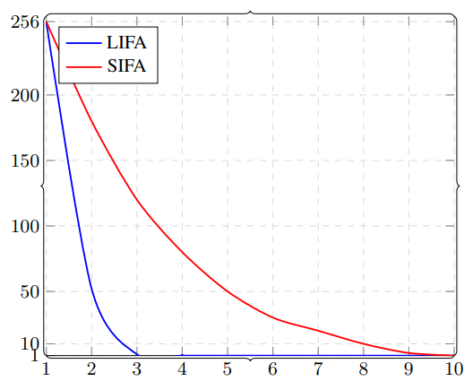
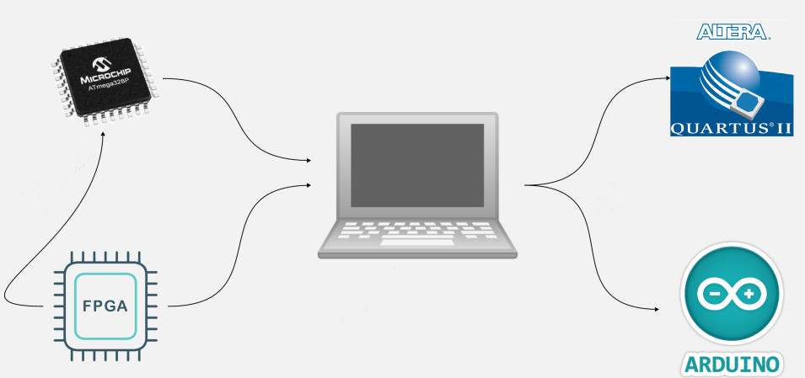
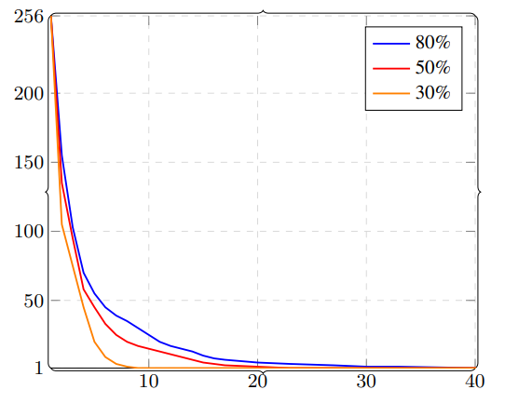
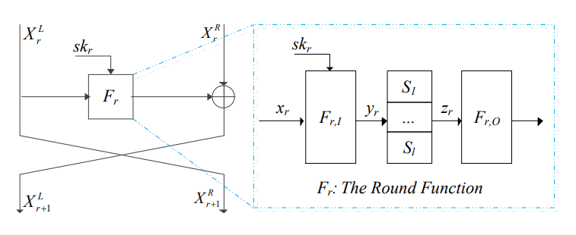
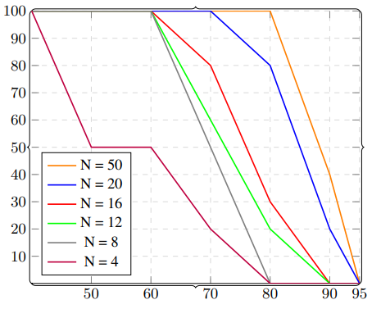
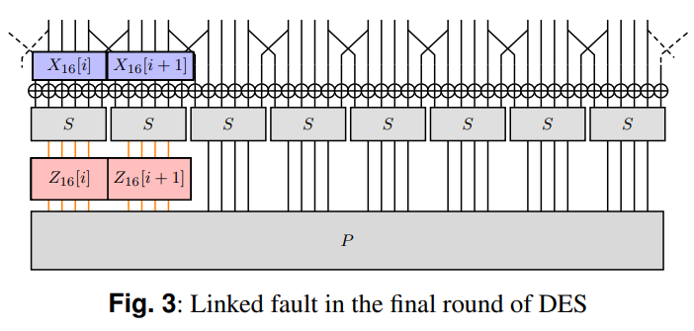

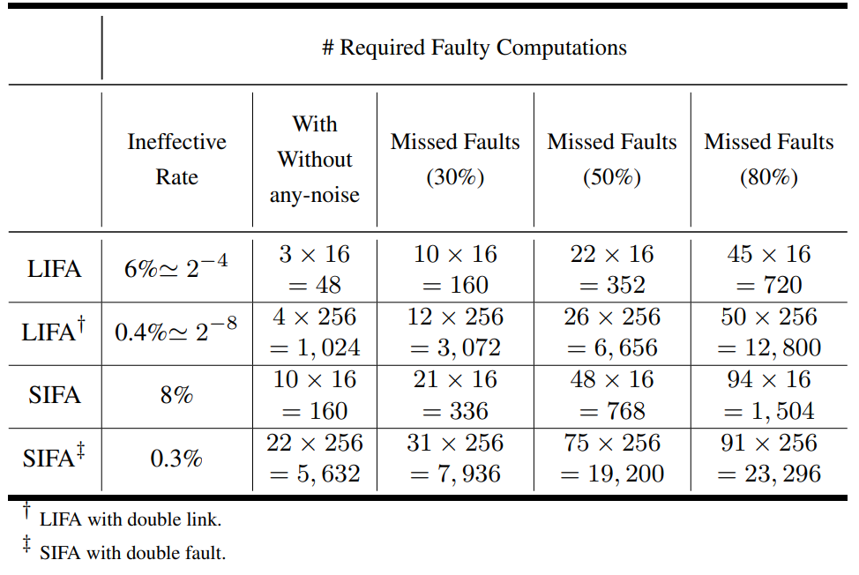
Linked Ineffective Fault Analysis on DES
V. Soleimani Hesari, H. Soleimany, A.A. Beigizad, H. Ramzanipour
Shahid Beheshti University (SBU), SRTTU
Published in ISecure Journal – Presented at Iranian Cryptology Society
Introduction
Results / Findings
Experimental Setup
Fault attacks pose a significant threat to embedded cryptographic implementations. Linked Ineffective Fault Analysis (LIFA) represents a class of attacks that can bypass redundancy-based countermeasures even in the absence of adversarial control over the input. While LIFA has been investigated primarily in the context of Substitution–Permutation Network (SPN) ciphers, its applicability to Feistel constructions has remained insufficiently understood. This work bridges that gap by demonstrating an efficient LIFA attack on a Feistel-cipher model instantiated with DES, thereby providing empirical evidence that Feistel architectures are likewise vulnerable to LIFA-induced leakage.
Figure 6 Hardware Setup
The DES encryption is implemented on an ATmega328P microcontroller, which serves as the target device under test. Fault injection is managed by an external FPGA platform that provides fine-grained timing control over the execution of encryption rounds. The FPGA overrides the internal clock source of the microcontroller with an externally generated clock signal and injects precisely timed frequency-glitch perturbations within a programmable temporal window. The host computer communicates with the FPGA to configure the glitch parameters, including the trigger position and offset relative to the encryption start event, and to automate fault-injection campaigns.
Ciphertexts corresponding to both effective and ineffective encryptions are retrieved through the Arduino serial interface and logged for offline LIFA processing and statistical analysis.
Figure 3 Comparison SIFA and LIFA in key recovery
Background
DES is a 16-round Feistel block cipher operating on 64-bit data blocks with 8 S-boxes per round.
SIFA exploits biased distributions caused by ineffective faults to recover secret keys.
LIFA exploits deterministic relations between multiple intermediate values affected by a single fault.
Figure 1 Generalized round of a Feistel cipher
Figure 4 key recovery in presence of missed faults
Future Work
Future work includes extending LIFA to other Feistel-based ciphers and later rounds,
as well as analyzing its interaction with stronger fault countermeasures and different fault models.
Attack Method Overview
A transient instruction-skip fault is injected during the last round of DES.
When the fault is ineffective, the output of two
Consecutive S-boxes becomes identical.
This creates a deterministic relation that always holds for the correct subkey.
Incorrect key hypotheses satisfy this relation only with low probability and are therefore discarded. Even in the presence of missed injections or unwanted faults, the linked relation remains statistically dominant for the correct key, so key recovery remains reliable as more ineffective ciphertexts are collected. Owing to the nibble-based structure of the DES S-boxes, a single injection can generate two simultaneous and statistically independent links, enabling parallel recovery of larger subkey portions with reduced data requirements.
Bibliography / References
[1] D. Boneh, R. A. DeMillo, and R. J. Lipton, “On the Importance of Checking Cryptographic Protocols for Faults,” in Advances in Cryptology – EUROCRYPT ’97, 1997, pp. 37–51.
[2] C. Dobraunig, M. Eichlseder, T. Korak, S. Mangard, F. Mendel, and R. Primas, “SIFA: Exploiting Ineffective Fault Inductions on Symmetric Cryptography,” IACR Transactions on Cryptographic Hardware and Embedded Systems (TCHES), 2018, pp. 547–572.
[3] A. A. Beigizad, H. Soleimany, S. Zarei, and H. Ramzanipour, “Linked Fault Analysis,” IEEE Transactions on Information Forensics and Security, vol. 19, pp. 632–645, 2024.
[4] National Institute of Standards and Technology (NIST), “Data Encryption Standard (DES),” Federal Information Processing Standards Publication (FIPS), 1999.
Figure 5 Success probability
Figure 2 Linked fault in the final round of DES
Table 1 shows 48 (LIFA) vs. 160 (SIFA) faulty execution needed in the noise-free case
Table 1 quantifies the data increase to 160/352/720 executions for 30/50/80% missed faults.
Fig5: The plotted success probabilities correspond to same data points reported in Table 1.
Table 1 Statistical characterization of outcomes

